Slide 1

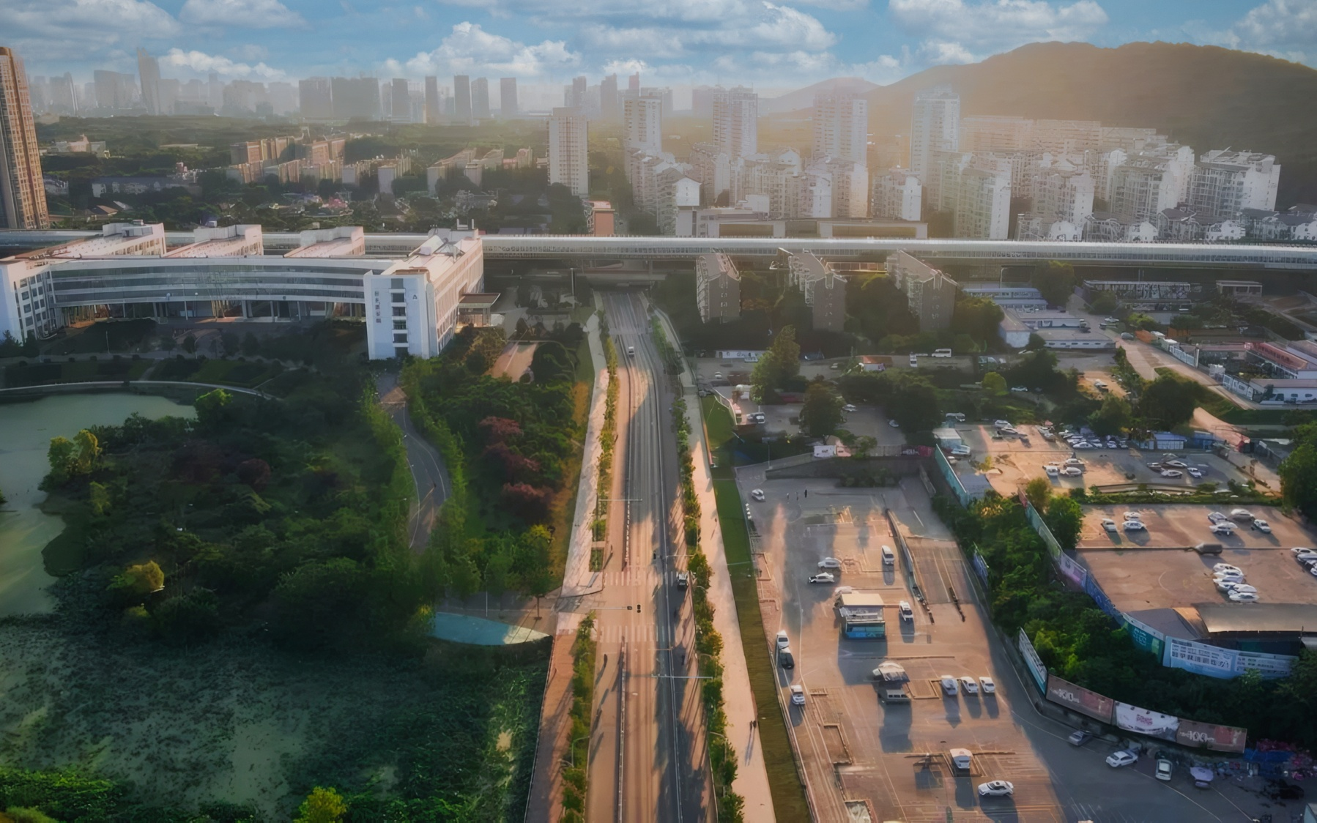
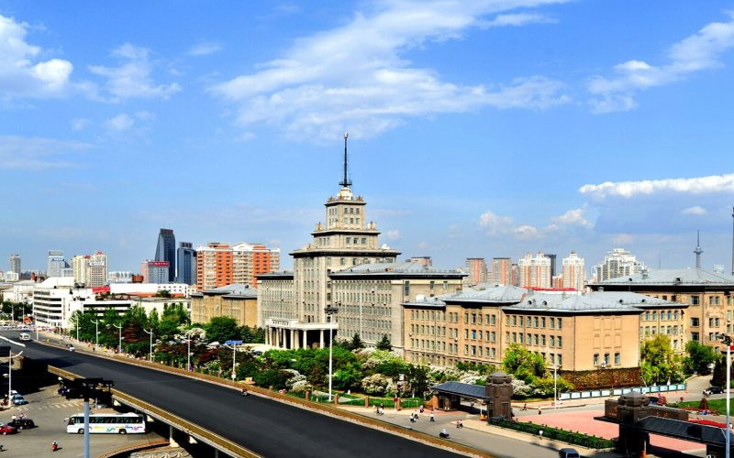

HSVmode:HV
开题报告
华中科技大学汇报
The user can demonstrate on a projector or computer, or print the demonstrate on a projector or computer, or print the presentationpresentation
选题背景 | 研究方法 | 研究成果 | 设计总结
答辩人：XX| 指导老师：XXX

Slide 2
开题报告
目 录
选题背景
研究方法
The user can demonstrate on a projector or computer, or print the demonstrate on a
The user can demonstrate on a projector or computer, or print the demonstrate on a
研究成果
设计总结
The user can demonstrate on a projector or computer, or print the demonstrate on a
The user can demonstrate on a projector or computer, or print the demonstrate on a

Slide 3
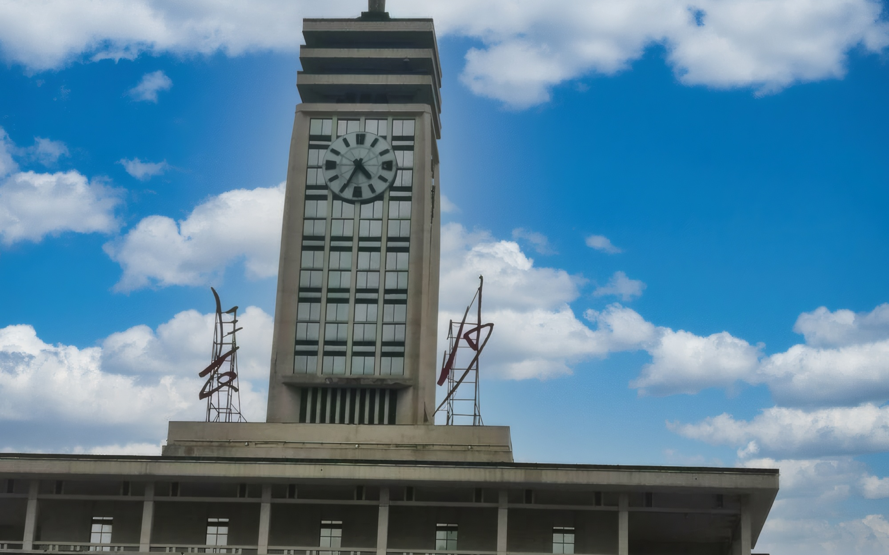
开题报告
PART.01
选题背景
The user can demonstrate on a projector or computer, or print the demonstrate on a projector or computer, or print the presentationpresentation

Slide 4


开题报告
标题添加
The user can demonstrate on a projector or computer, or print the presentation and make it into a film to be used in a wider field.
60%
标题文字添加
The user can demonstrate on a projector or computer, or presentation and make it film to be used in a wider field

Slide 5
开题报告
标题文字添加
标题文字添加
标题文字添加
标题文字添加
The user can demonstrate on a projector or computer
The user can demonstrate on a projector or computer
The user can demonstrate on a projector or computer
The user can demonstrate on a projector or computer

Slide 6
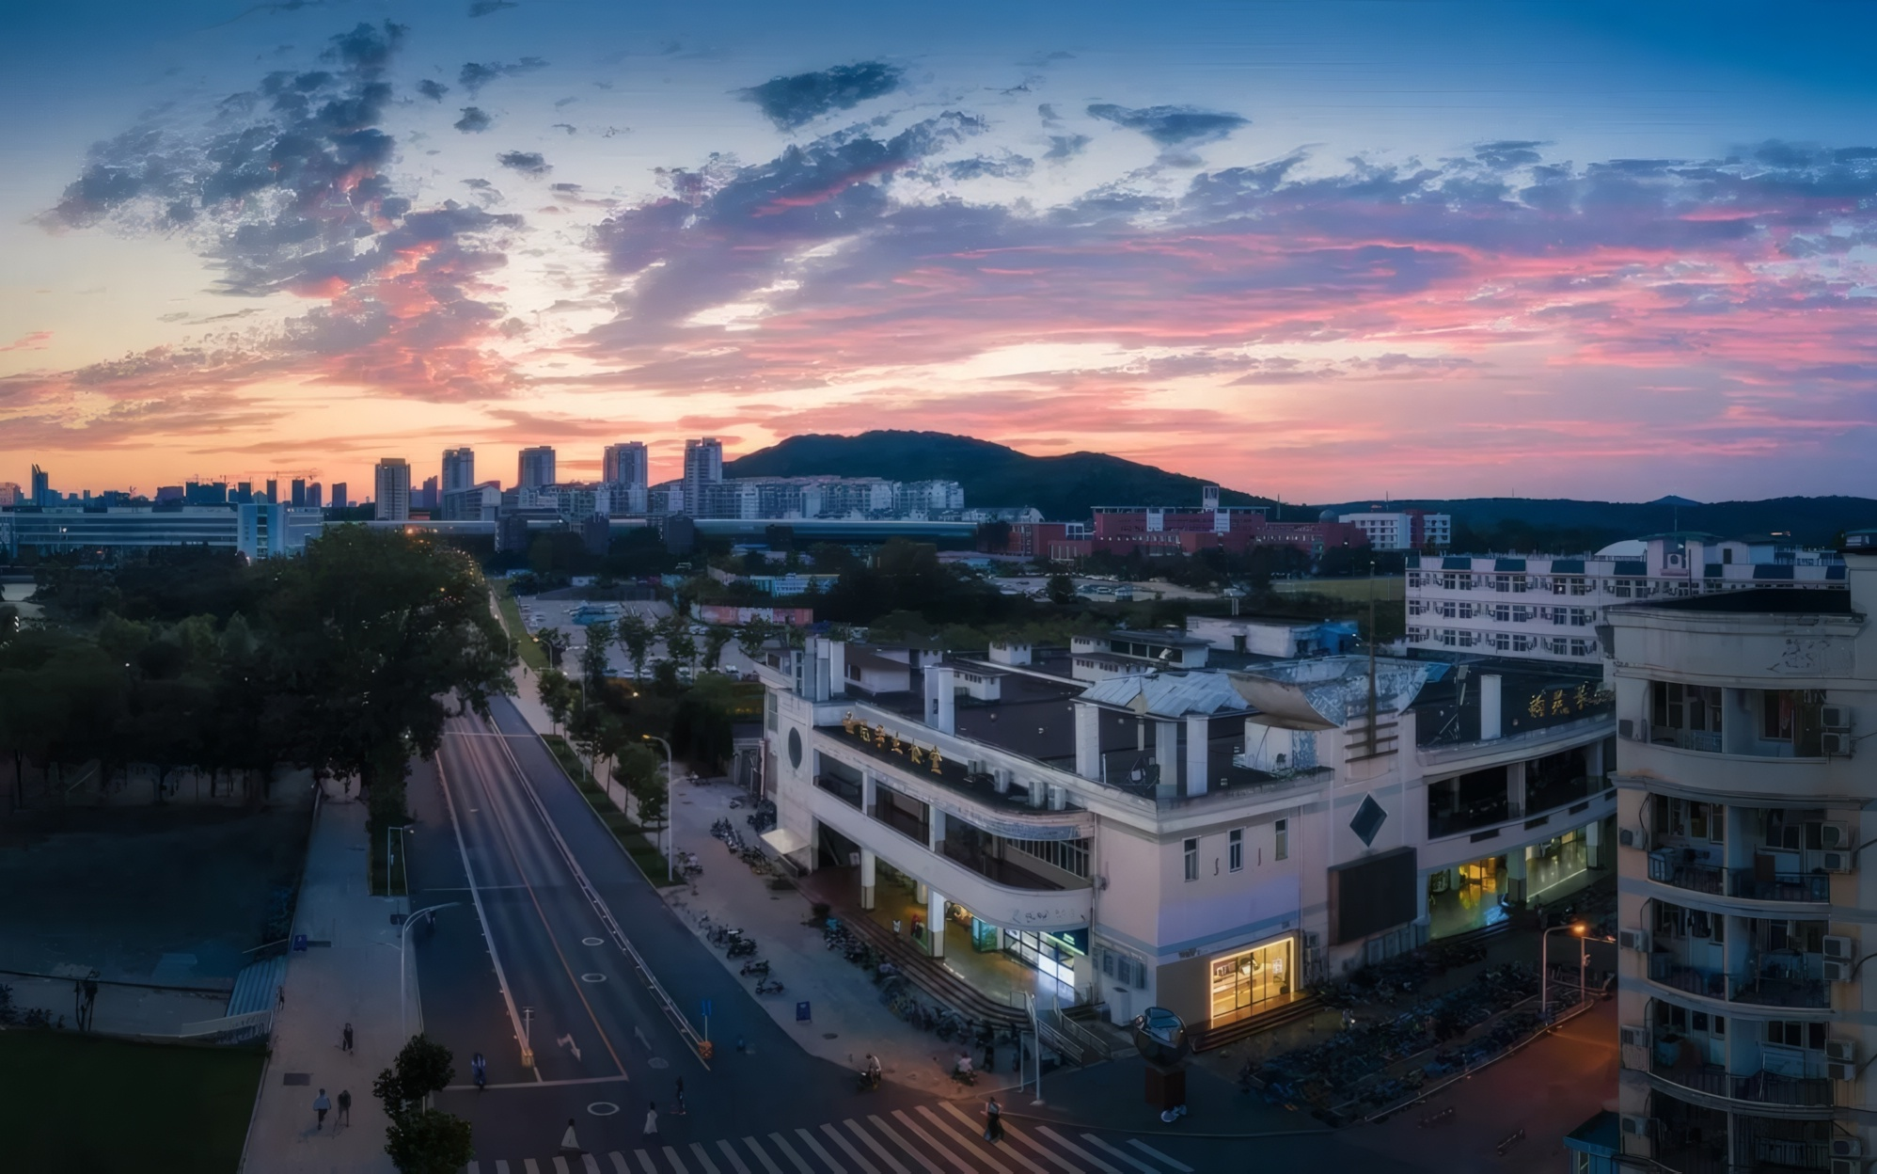
开题报告
标题文字添加
The user can demonstrate on a projector or computer, or presentation and make it film to be used in a wider field
标题文字添加
标题文字添加
The user can demonstrate on a projector or computer, or presentation and make it film to be used in a wider field
The user can demonstrate on a projector or computer, or presentation and make it film to be used in a wider field

Slide 7
开题报告
标题文字添加
标题文字添加
The user can demonstrate on a projector or computer, or print the presentation and make it into a film to be used in a wider field.
The user can demonstrate on a projector or computer, or print the presentation and make it into a film to be used in a wider field.
添加
标题
标题文字添加
标题文字添加
The user can demonstrate on a projector or computer, or print the presentation and make it into a film to be used in a wider field.
The user can demonstrate on a projector or computer, or print the presentation and make it into a film to be used in a wider field.

Slide 8

开题报告
PART.02
研究方法
The user can demonstrate on a projector or computer, or print the demonstrate on a projector or computer, or print the presentationpresentation

Slide 9

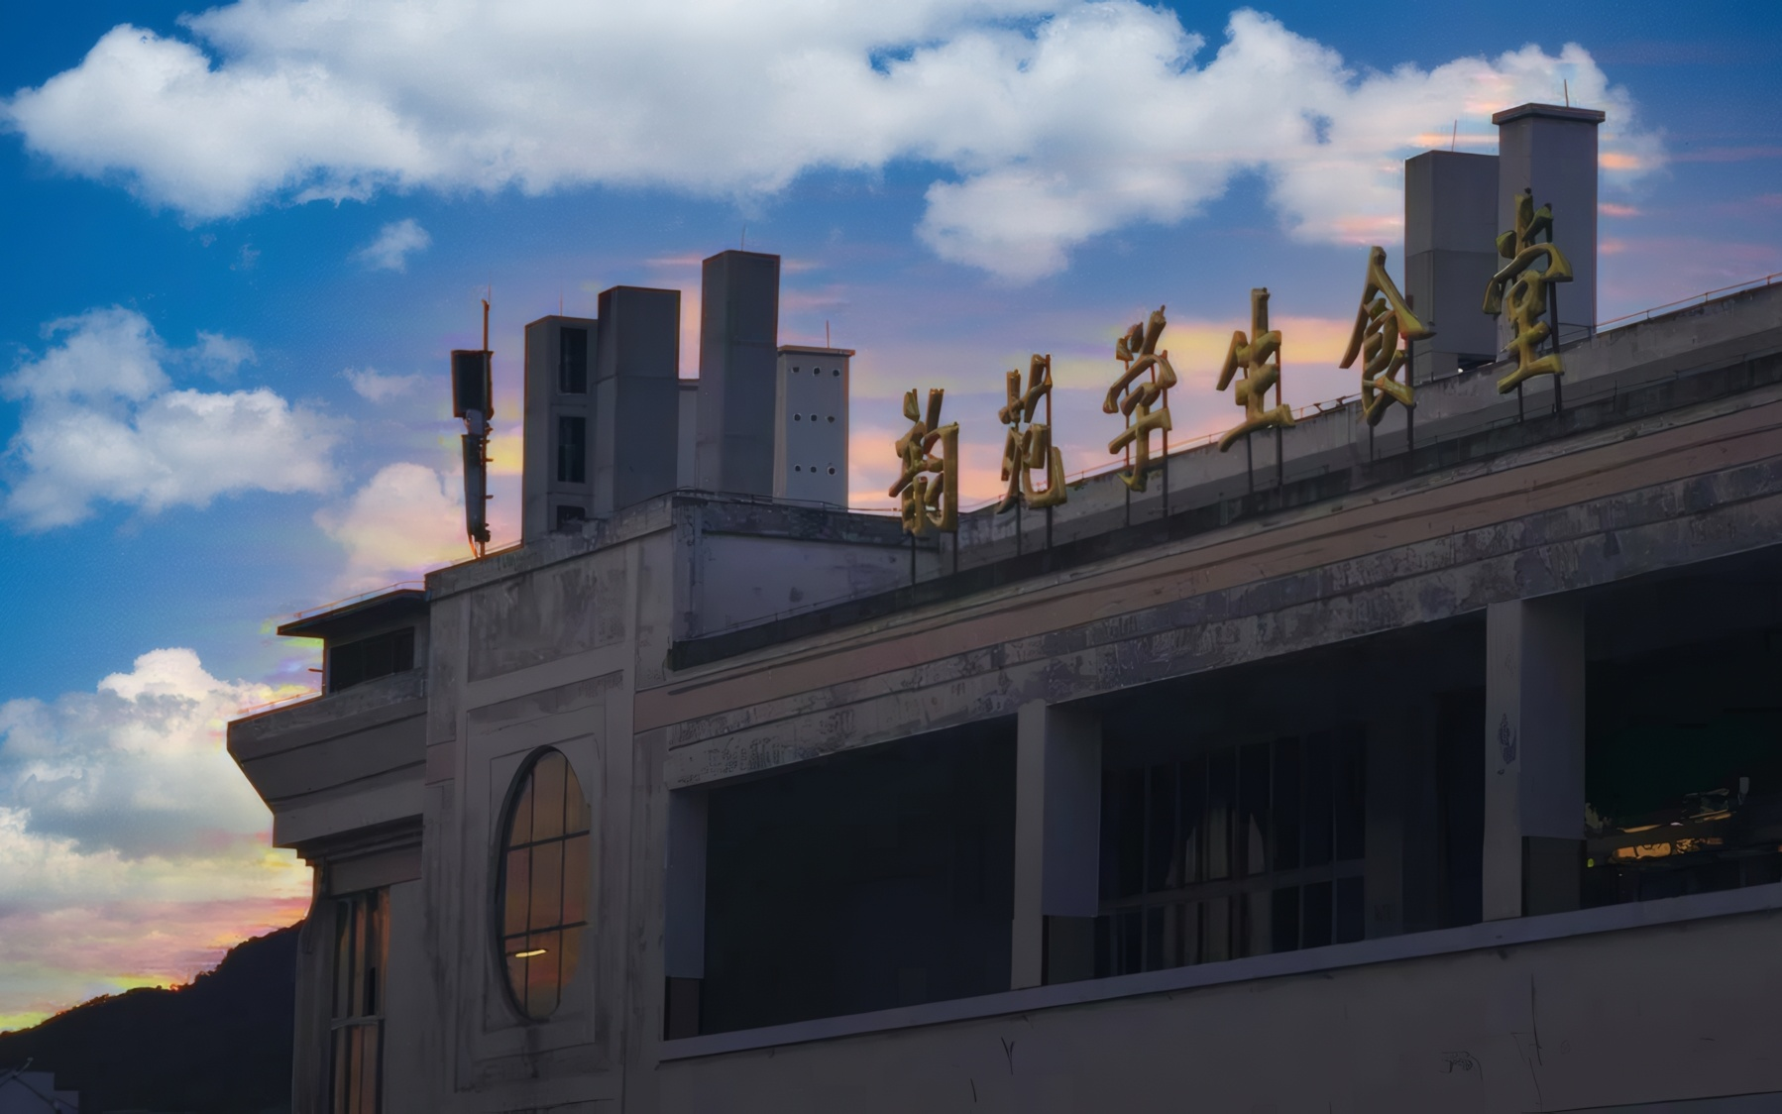
开题报告
PROJECTOR
标题文字添加
标题文字添加
The user can demonstrate on a projector or computer, or presentation and make it film to be used in a wider field
The user can demonstrate on a projector or computer, or presentation and make it film to be used in a wider field

Slide 10



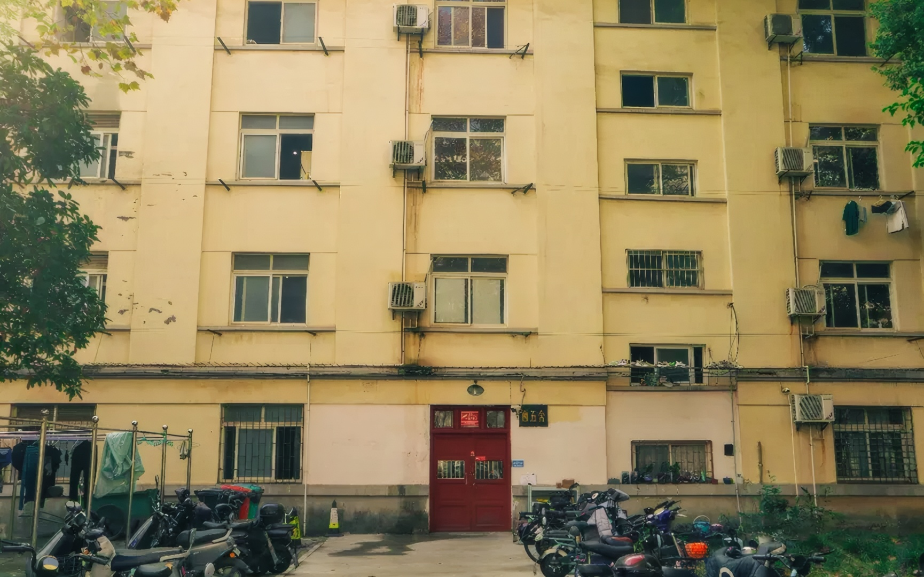
开题报告
标题文字添加
The user can demonstrate on a projector or computer, or presentation and make it film to be used in a wider field
标题文字添加
标题文字添加
01
The user can demonstrate on a projector or computer, or presentation and make it film to be used in a wider field
02
The user can demonstrate on a projector or computer, or presentation and make it film to be used in a wider field

Slide 11
开题报告
标题文字添加
标题文字添加
The user can demonstrate on a projector or computer, or presentation and make it film to be used in a wider field
The user can demonstrate on a projector or computer, or presentation and make it film to be used in a wider field
标题文字添加
标题文字添加
The user can demonstrate on a projector or computer, or presentation and make it film to be used in a wider field
The user can demonstrate on a projector or computer, or presentation and make it film to be used in a wider field

Slide 12
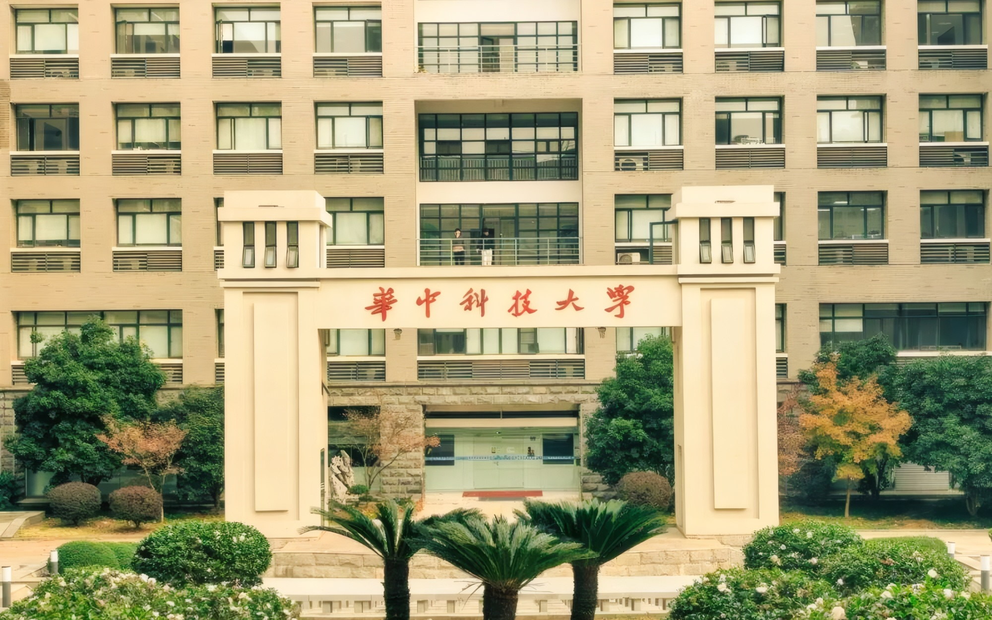
开题报告
PART.03
研究成果
The user can demonstrate on a projector or computer, or print the demonstrate on a projector or computer, or print the presentationpresentation

Slide 13
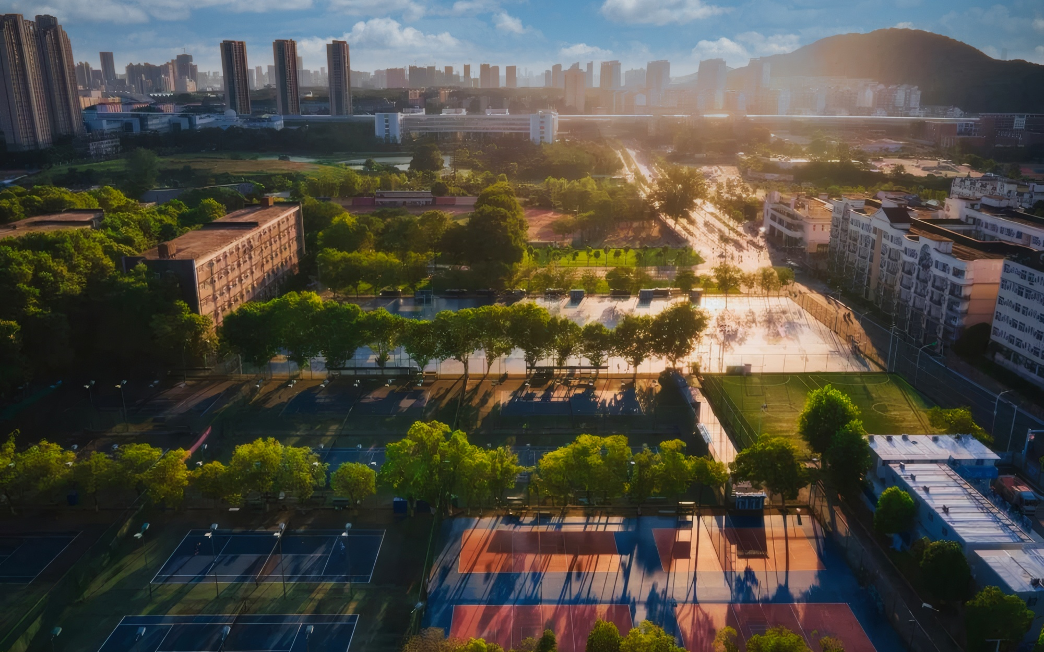
开题报告
标题文字添加
The user can demonstrate on a projector or computer, or presentation and make it film to be used in a wider field
1
标题文字添加
The user can demonstrate on a projector or computer, or presentation and make it film to be used in a wider field
2
标题文字添加
The user can demonstrate on a projector or computer, or presentation and make it film to be used in a wider field

Slide 14
开题报告
标题文字添加
The user can demonstrate on a projector or computer, or presentation and make it film to be used in a wider fieldnar. The user can demonstrate on a projector or computer, or presentation and make it film to be used in a wider fieldnar.
标题文字添加
The user can demonstrate on a projector or computer, or presentation and make it film to be used in a wider fieldnar. The user can demonstrate on a projector or computer, or presentation and make it film to be used in a wider fieldnar.

Slide 15
开题报告
标题文字添加
标题文字添加
标题文字添加
The user can demonstrate on a projector or computer, or presentation and make it film to be used in a wider field
The user can demonstrate on a projector or computer, or presentation and make it film to be used in a wider field
The user can demonstrate on a projector or computer, or presentation and make it film to be used in a wider field
1
2
3
4
5
标题文字添加
标题文字添加
The user can demonstrate on a projector or computer, or presentation and make it film to be used in a wider field
The user can demonstrate on a projector or computer, or presentation and make it film to be used in a wider field

Slide 16
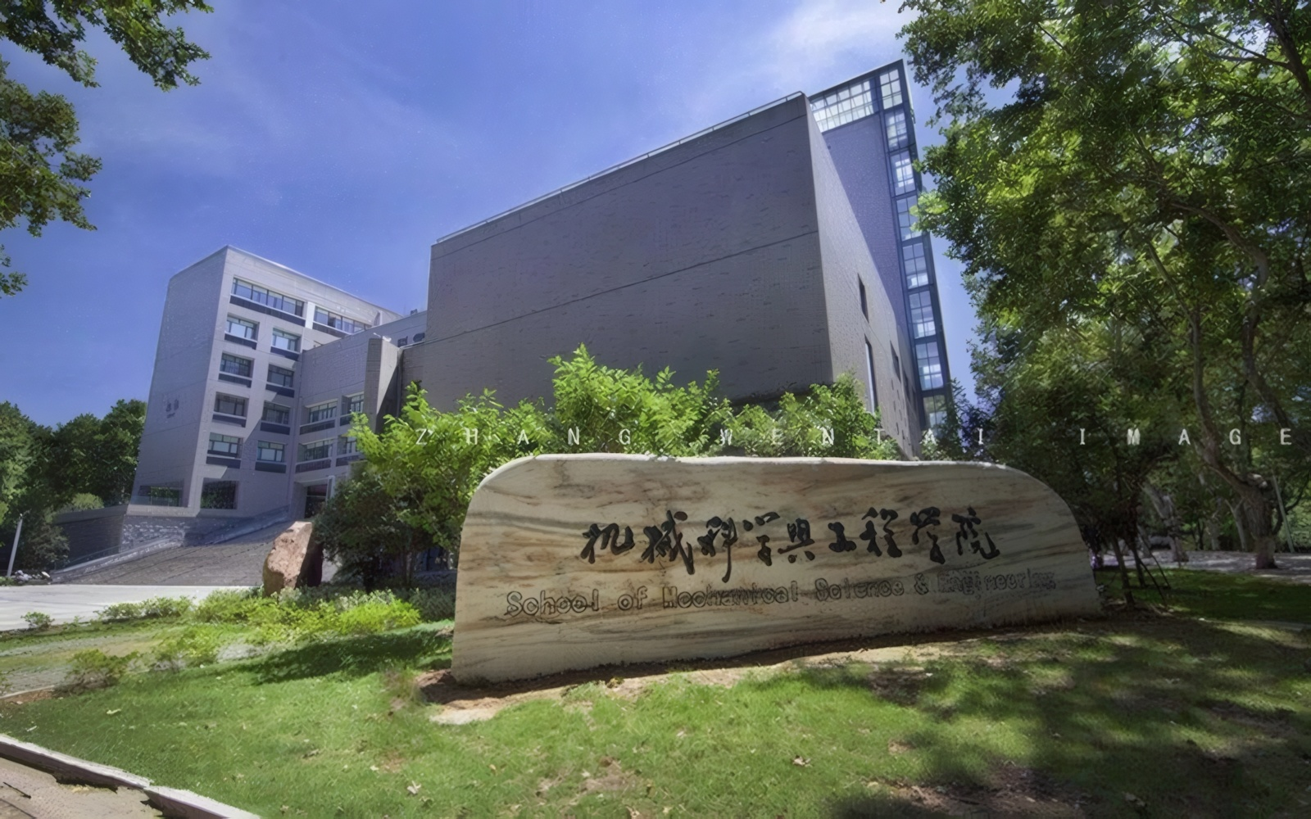
开题报告
PART.04
设计总结
The user can demonstrate on a projector or computer, or print the demonstrate on a projector or computer, or print the presentationpresentation

Slide 17
开题报告
标题文字添加
The user can demonstrate on a projector or computer, or presentation and make it film to be used in a wider field
标题文字添加
The user can demonstrate on a projector or computer, or presentation and make it film to be used in a wider field
标题文字添加
The user can demonstrate on a projector or computer, or presentation and make it film to be used in a wider field
标题文字添加
The user can demonstrate on a projector or computer, or presentation and make it film to be used in a wider field

Slide 18

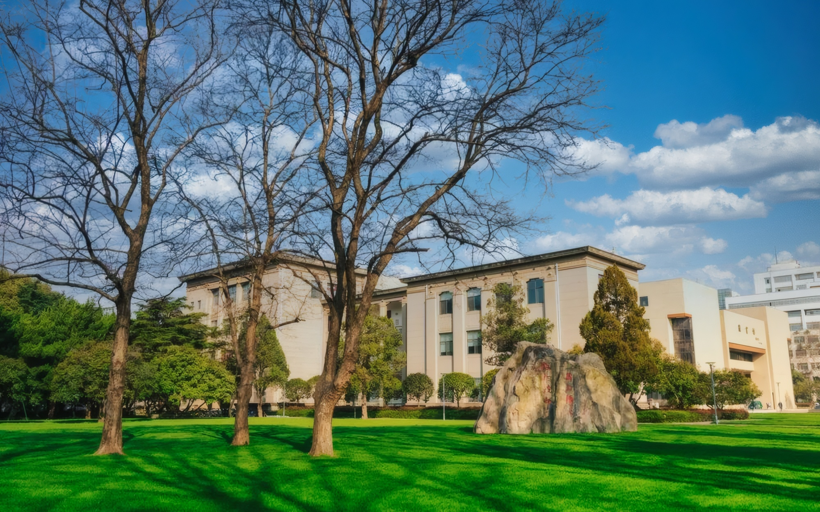
开题报告
标题添加
The user can demonstrate on a projector or computer, or print the presentation and make it into a film to be used in a wider field. The user can demonstrate on a projector or computer, or print the presentation and make it into a film to be used in a wider field.

Slide 19

开题报告
1
标题文字添加
The user can demonstrate on a projector or computer, or print the presentation and make it into a film to be used in a wider field.
2
标题文字添加
The user can demonstrate on a projector or computer, or print the presentation and make it into a film to be used in a wider field.

Slide 20

开题报告
THANK YOU
The user can demonstrate on a projector or computer, or print the demonstrate on a projector or computer, or print the presentationpresentation
选题背景 | 研究方法 | 研究成果 | 设计总结
答辩人：XX| 指导老师：XXX

